Slide 1




Futurion
Data Analysis
UPSKILLING INDIA
Portfolio Project Challenge
LUNG CANCER ANALYTICS
Name: Monday Ochedi
Date of Submission: 20th February, 2025
Tools: SQL + Power BI/Excel
01
LinkedIn

Slide 2
Futurion
UPSKILLING INDIA
PROBLEM STATEMENT
A major problem with Lung Cancer is its high mortality rate due to certain factors like late-stage diagnosis, Cigarettes consumption, exposure to Air pollution and others. It has resulted into a significant public health concern requiring improved methods and treatment strategies to increase survival rates.
The goal of the analysis is to help in identifying high-risk individuals, studying smoking-related lung cancer trends, and developing early detection strategies.
OBJECTIVES
1. Analyze Lung Cancer trends, cause and impact
2. Create a Dashboard using any BI tool to visualize key metrics and insights
3. Provide actionable and data driven recommendation
02
Monday Ochedi

Slide 3
Futurion
UPSKILLING INDIA
DATASET OVERVIEW
Dataset contains patient records that help in analysing risk factors associated with lung cancer.
It contains 25 fields/columns:
ID, Country, Population_Size, Age, Gender, Smoker, Years_of_Smoking, Cigarettes_per_Day, Passive_Smoker, Family_History, Lung_Cancer_Diagnosis, Cancer_Stage, Survival_Years, Adenocarcinoma_Type, Air_Pollution_Exposure, Occupational_Exposure, Indoor_Pollution, Healthcare_Access, Early_Detection, Treatment_Type, Developed_or_Developing, Annual_Lung_Cancer_Deaths, Lung_Cancer_Prevalence_Rate, Mortality_Rate
Total Records/Rows: 220,632
Source: Portfolio Project Challenge
Data cleaning/pre-processing:
Extracted a new column "Survival Rate" from "Mortality Rate"
Extracted an "Age (Group)" column from "Age"
Ensured data consistency and standardization across all fields
03
Monday Ochedi

Slide 4
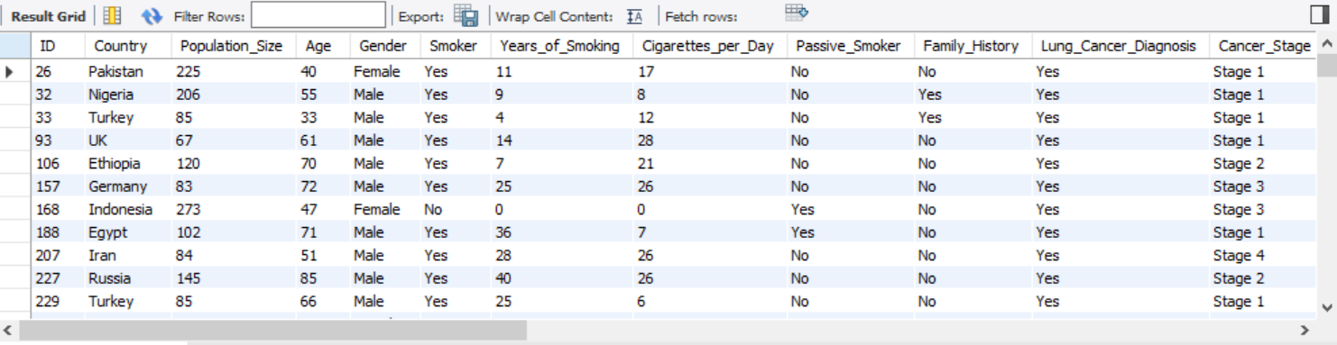
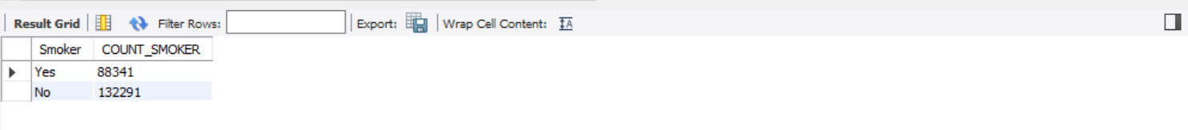
Futurion
UPSKILLING INDIA
SQL Queries & Solutions: BASIC LEVEL
1. Retrieve all records for individuals diagnosed with lung cancer.
SELECT * FROM lung_cancer_data
WHERE Lung_Cancer_Diagnosis = "Yes";
2. Count the number of smokers and non-smokers.
SELECT Smoker, COUNT(Smoker) AS COUNT_SMOKER FROM lung_cancer_data
GROUP BY Smoker;
04
Monday Ochedi

Slide 5
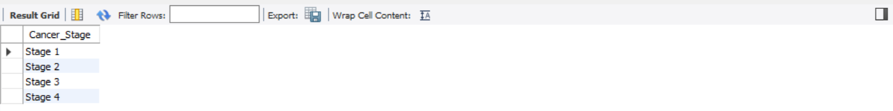
Futurion
UPSKILLING INDIA
3. List all unique cancer stages present in the dataset.
SELECT DISTINCT Cancer_Stage FROM lung_cancer_data
WHERE Cancer_Stage != "None";
4. Retrieve the average number of cigarettes smoked per day by smokers.
SELECT AVG(Cigarettes_per_Day) AS AVERAGE_CIGARETTES_SMOKER_PER_DAY FROM lung_cancer_data;
05
Monday Ochedi

Slide 6
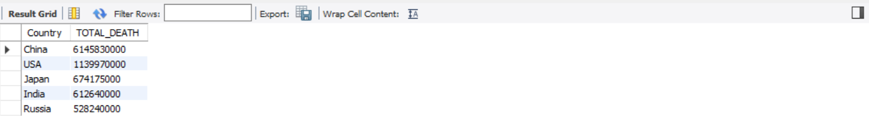
Futurion
UPSKILLING INDIA
5. Count the number of people exposed to high air pollution.
SELECT COUNT(Air_Pollution_Exposure) AS HIGH_AIR_POLLUTION FROM lung_cancer_data
WHERE Air_Pollution_Exposure = "High";
6. Find the top 5 countries with the highest lung cancer deaths.
SELECT Country, SUM(Annual_Lung_Cancer_Deaths) AS TOTAL_DEATH FROM lung_cancer_data
GROUP BY Country
ORDER BY TOTAL_DEATH DESC
LIMIT 5;
06
Monday Ochedi

Slide 7
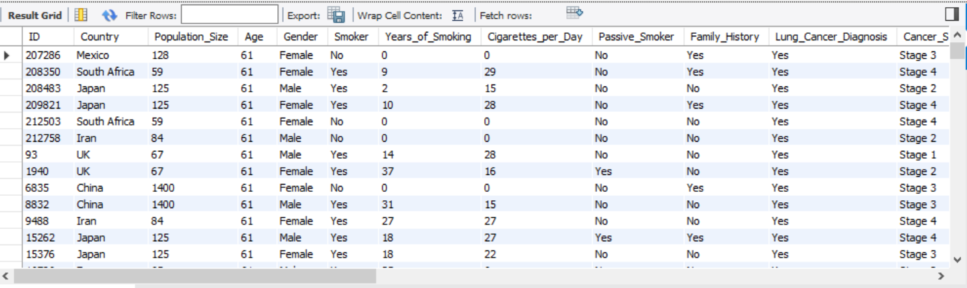
Futurion
UPSKILLING INDIA
7. Count the number of people diagnosed with lung cancer by gender.
SELECT Gender, COUNT(Lung_Cancer_Diagnosis) AS COUNT_PEOPLE FROM lung_cancer_data
WHERE Lung_Cancer_Diagnosis = "Yes"
GROUP BY Gender;
8. Retrieve records of individuals older than 60 who are diagnosed with lung cancer.
SELECT * FROM lung_cancer_data
WHERE Age > 60 AND Lung_Cancer_Diagnosis = "Yes"
ORDER BY AGE ASC;
07
Monday Ochedi

Slide 8
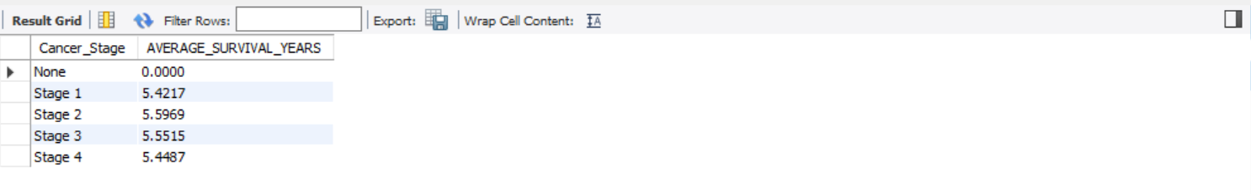
Futurion
UPSKILLING INDIA
SQL Queries & Solutions: INTERMEDIATE LEVEL
Find the percentage of smokers who developed lung cancer.
SELECT
(COUNT(CASE WHEN Smoker = "Yes" AND Lung_Cancer_Diagnosis = "Yes" THEN 1 END)
/ COUNT(CASE WHEN Smoker = "Yes" THEN 1 END )) * 100 AS PERCENTAGE_SMOKERS_DEVELOPED_LUNG_CANCER
FROM lung_cancer_data;
2. Calculate the average survival years based on cancer stages.
SELECT Cancer_Stage, AVG(Survival_Years) AS AVERAGE_SURVIVAL_YEARS FROM lung_cancer_data
GROUP BY Cancer_Stage
08
Monday Ochedi

Slide 9
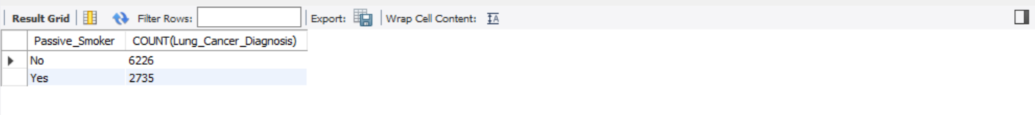
Futurion
UPSKILLING INDIA
3. Count the number of lung cancer patients based on passive smoking.
SELECT COUNT(Lung_Cancer_Diagnosis), Passive_Smoker from lung_cancer_data
WHERE Lung_Cancer_Diagnosis = "Yes"
GROUP BY Passive_Smoker;
4. Find the country with the highest lung cancer prevalence rate.
SELECT Country, AVG(Lung_Cancer_Prevalence_Rate) AS HIGHEST_PREVALENCE_RATE FROM lung_cancer_data
GROUP BY Country
ORDER BY Country DESC
LIMIT 1;
09
Monday Ochedi

Slide 10
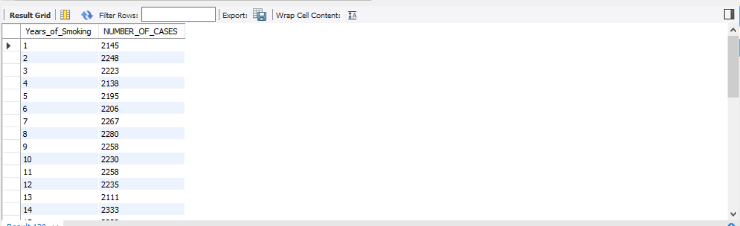
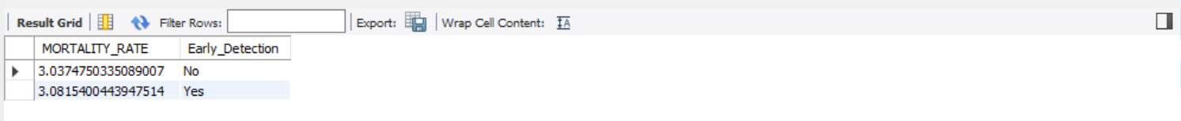
Futurion
UPSKILLING INDIA
5. Identify the smoking years' impact on lung cancer.
SELECT Years_of_Smoking, COUNT(*) AS NUMBER_OF_CASES FROM lung_cancer_data
WHERE Smoker = "Yes"
GROUP BY Years_of_Smoking
ORDER BY Years_of_Smoking ASC;
6. Determine the mortality rate for patients with and without early detection.
SELECT AVG(Mortality_Rate) AS MORTALITY_RATE, Early_Detection FROM lung_cancer_data
GROUP BY Early_Detection;
10
Monday Ochedi

Slide 11
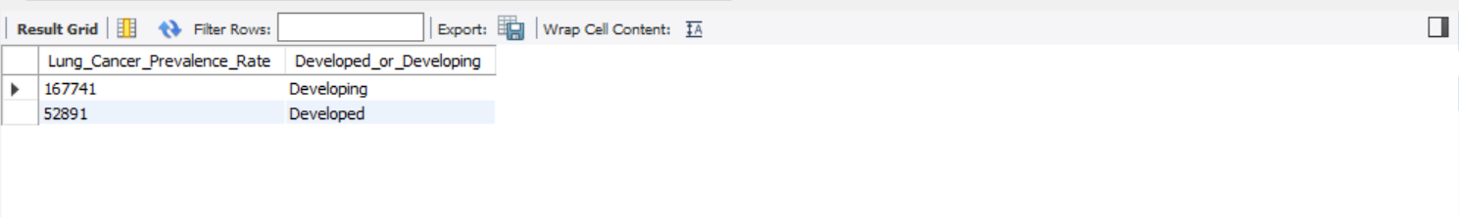
Futurion
UPSKILLING INDIA
7. Group the lung cancer prevalence rate by developed vs. developing countries.
SELECT COUNT(Lung_Cancer_Prevalence_Rate) AS Lung_Cancer_Prevalence_Rate, Developed_or_Developing FROM lung_cancer_data
GROUP BY Developed_or_Developing;
11
Monday Ochedi

Slide 12
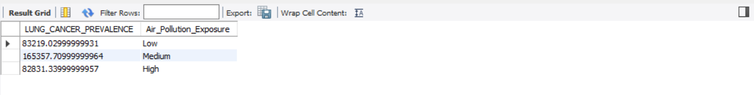
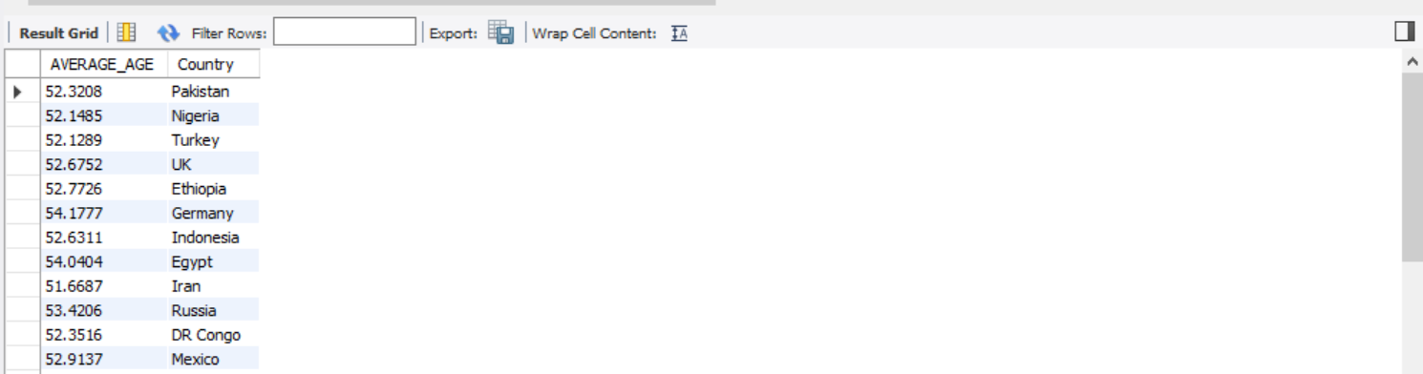
Futurion
UPSKILLING INDIA
SQL Queries & Solutions: ADVANCED LEVEL
1. Identify the correlation between lung cancer prevalence and air pollution levels.
SELECT SUM(Lung_Cancer_Prevalence_Rate) AS LUNG_CANCER_PREVALENCE, Air_Pollution_Exposure FROM lung_cancer_data
GROUP BY Air_Pollution_Exposure;
2. Find the average age of lung cancer patients for each country.
SELECT AVG(Age) AS AVERAGE_AGE, Country FROM lung_cancer_data
WHERE Lung_Cancer_Diagnosis = "Yes"
GROUP BY Country;
12
Monday Ochedi

Slide 13
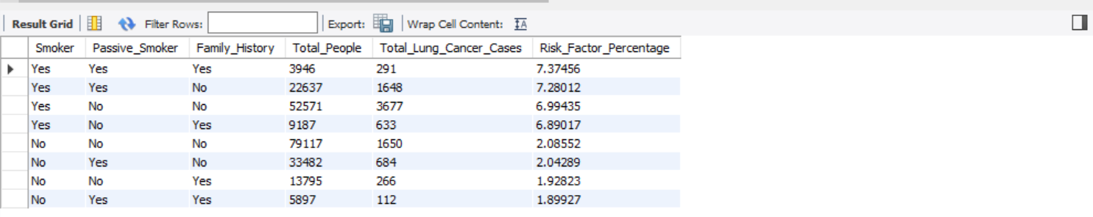
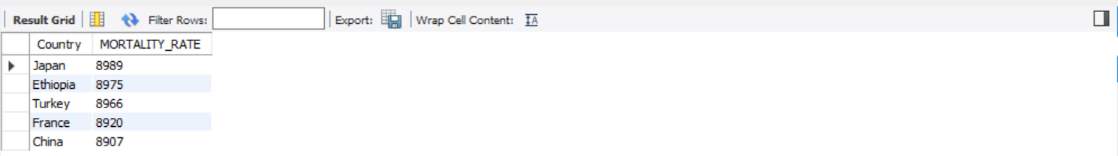
Futurion
UPSKILLING INDIA
3. Calculate the risk factor of lung cancer by smoker status, passive smoking, and family history.
SELECT Smoker, Passive_Smoker, Family_History, COUNT(*) AS Total_People,
SUM(CASE WHEN Lung_Cancer_Diagnosis = 'Yes' THEN 1 END) AS Total_Lung_Cancer_Cases,
(SUM(CASE WHEN Lung_Cancer_Diagnosis = 'Yes' THEN 1 END) * 100.0 / COUNT(*)) AS Risk_Factor_Percentage
FROM lung_cancer_data
GROUP BY Smoker, Passive_Smoker, Family_History
ORDER BY Risk_Factor_Percentage DESC;
4. Rank countries based on their mortality rate.
SELECT Country, COUNT(Mortality_Rate) AS MORTALITY_RATE FROM lung_cancer_data
GROUP BY Country
ORDER BY MORTALITY_RATE DESC
LIMIT 5;
13
Monday Ochedi

Slide 14
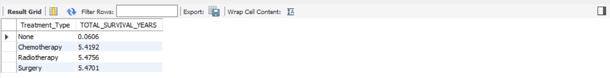
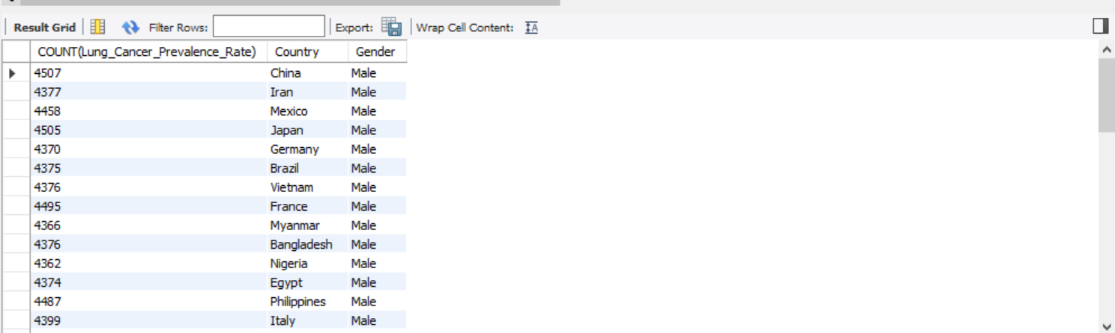
Futurion
UPSKILLING INDIA
5. Determine if treatment type has a significant impact on survival years.
SELECT Treatment_Type, AVG(Survival_Years) AS TOTAL_SURVIVAL_YEARS FROM lung_cancer_data
GROUP BY Treatment_Type;
6. Compare lung cancer prevalence in men vs. women across countries.
SELECT COUNT(Lung_Cancer_Prevalence_Rate), Country, Gender FROM lung_cancer_data
GROUP BY Country, Gender
ORDER BY Gender DESC;
14
Monday Ochedi

Slide 15
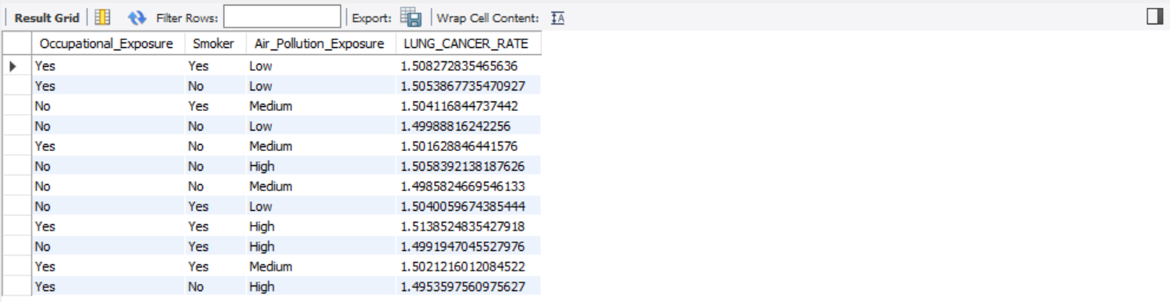
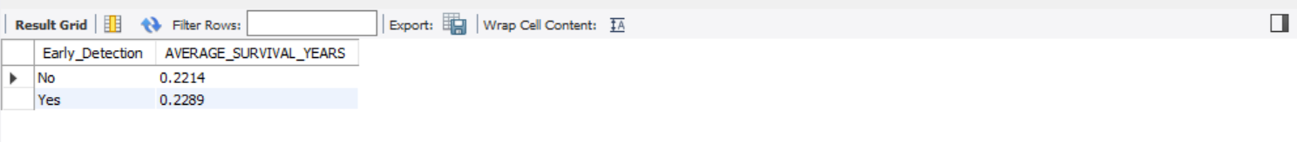
Futurion
UPSKILLING INDIA
7. Find how occupational exposure, smoking, and air pollution collectively impact lung cancer rates.
SELECT Occupational_Exposure, Smoker, Air_Pollution_Exposure, AVG(Lung_Cancer_Prevalence_Rate) AS LUNG_CANCER_RATE FROM lung_cancer_data
GROUP BY Occupational_Exposure, Smoker, Air_Pollution_Exposure;
8. Analyze the impact of early detection on survival years.
SELECT Early_Detection, AVG(Survival_Years) AS AVERAGE_SURVIVAL_YEARS FROM lung_cancer_data
GROUP BY Early_Detection;
15
Monday Ochedi

Slide 16
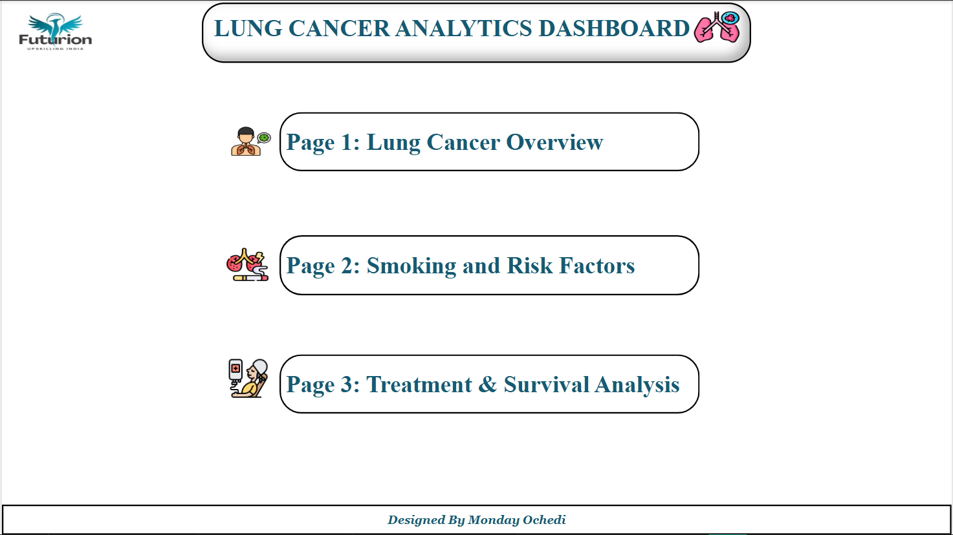
Futurion
UPSKILLING INDIA
DATA VISUALIZATION AND DASHBOARD
16

Slide 17
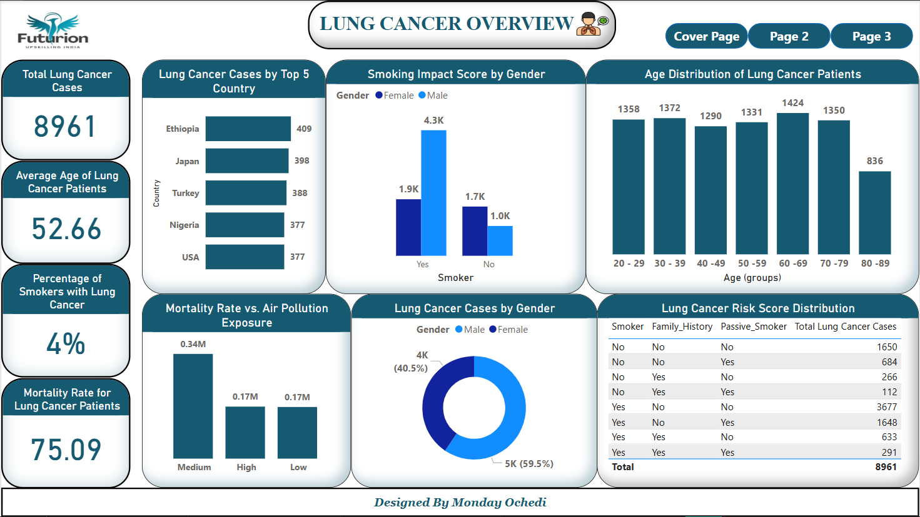
Futurion
UPSKILLING INDIA
DATA VISUALIZATION AND DASHBOARD
17

Slide 18
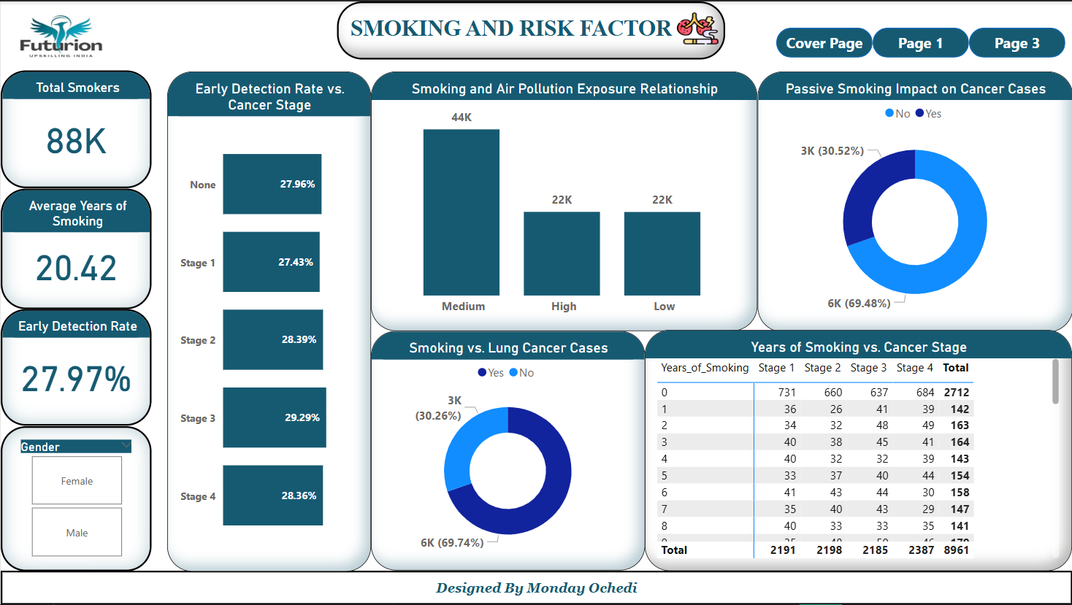
Futurion
UPSKILLING INDIA
DATA VISUALIZATION AND DASHBOARD
18

Slide 19
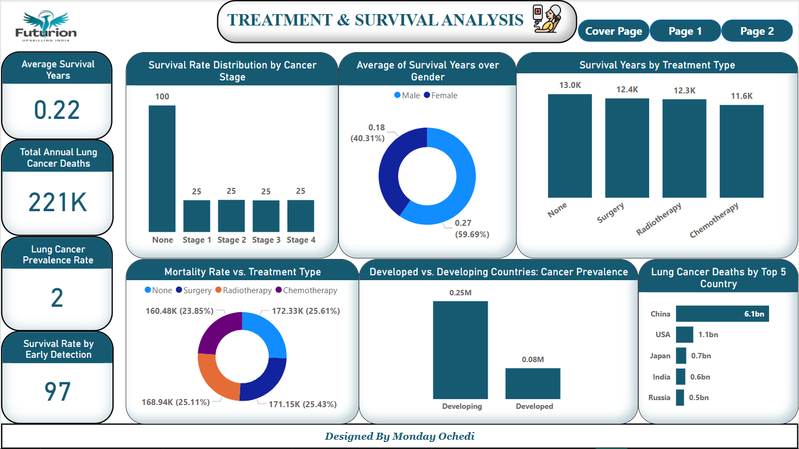
Futurion
UPSKILLING INDIA
DATA VISUALIZATION AND DASHBOARD
19

Slide 20
Futurion
UPSKILLING INDIA
KEY INSIGHTS AND CONCLUSION
A Total of 8961 Lung Cancer cases was recorded
Lung Cancer Cases was highest for Ethiopia at 409 accounting for 20.99% of Total Lung Cancer Cases, followed by Japan and Turkey.﻿
Total Lung Cancer Cases was higher for Male at 59.5% (5332) than Female at 40.5% (3629).﻿
Patients within the Age group of 60-69 had the highest incident of Lung Cancer with 1424 diagnosed cases
﻿Stage 3 Lung Cancer Stage had the highest Early Detection Rate of 29.29% and was 6.78% higher than Stage 1, which had the lowest Early Detection Rate at 27.43%.﻿
﻿None (No Cancer Stage) had the highest Survival Rate by Early Detection at 100 and was 300.19% higher than Stage 3, which had the lowest Survival Rate by Early Detection at 25.﻿
Late Diagnosis Increased Mortality Rate which led to poor Survival Rate
20
Monday Ochedi

Slide 21
Futurion
UPSKILLING INDIA
REFERENCES AND ACKNOWLEDGEMENT
Data Source: Sakshi Mogal Github
I extend my deepest gratitude to the following individuals and organizations for their invaluable support and contributions to my growth:
The entire SKYHUB Nigeria Team for their unwavering encouragement and guidance
Prof. Solomon Kershima Yateghtegh (mncs) and Mr. Isaiah Emaikwu for their relentless push and drive, helping me always deliver my best
My friends Emmanuel Bala and Alexander Aba for their insightful contributions in mapping out logical concepts that facilitated this project’s success
Tools and Software
This project was made possible with the aid of the following tools:
MySQL Workbench
Microsoft Power BI
Microsoft Excel
21
Monday Ochedi

